Slide 1
Minimal APIs in the Field
Make ASP.NET Core Minimal APIs work in your LOB apps
Kenny Pflug
Tech Lead at Synnotech

Slide 2
Table of Contents
Introduction to the new WebApplication model
How to structure HTTP endpoints with Minimal APIs
Composing the web app
Dependency Injection and Model Binding
Swagger Support
Automated testing
Parameter and DTO Validation
Performance of Minimal APIs vs MVC

Slide 3
Minimal APIs with ASP.NET Core
Where is all my code?

Slide 4
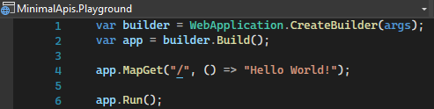
Minimal APIs – Default Template

Slide 5
CreateHostBuilder and Startup are gone
public static class Program
{
public static void Main(string[] args)
{
CreateHostBuilder(args).Build().Run();
}
public static IHostBuilder CreateHostBuilder(string[] args) =>
Host.CreateDefaultBuilder(args)
.ConfigureWebHostDefaults(builder => builder.UseStartup<Startup>());
}
public class Startup
{
public void ConfigureServices(IServiceCollection services)
{
services.AddAuthentication();
services.AddMvc();
}
public void Configure(IApplicationBuilder app,
IWebHostEnvironment environment)
{
if (environment.IsDevelopment())
app.UseDeveloperExceptionPage();
app.UseRouting()
.UseAuthentication()
.UseEndpoints(builder => builder.MapControllers());
}
}
WebApplicationBuilder
WebApplication

Slide 6

Live Demo
ASP.NET Core Minimal APIs Playground
Startup and Configuration

Slide 7
Global Using Directives for Web SDK
using System;
using System.Collections.Generic;
using System.Linq;
using System.Net.Http;
using System.Net.Http.Json;
using Microsoft.AspNetCore.Builder;
using Microsoft.AspNetCore.Hosting;
using Microsoft.AspNetCore.Http;
using Microsoft.AspNetCore.Routing;
using Microsoft.Extensions.Configuration;
using Microsoft.Extensions.DependencyInjection;
using Microsoft.Extensions.Hosting;
using Microsoft.Extensions.Logging;
Source: https://github.com/dotnet/aspnetcore/issues/32451#issuecomment-870812382

Slide 8
Structuring HTTP endpoints

Slide 9
Mapping Endpoints with Delegates
The MapXXX methods take a delegate that will be called when a corresponding HTTP Request is received
The delegate can point to an anonymous method / lambda, or any other type of static or instance method

Slide 10
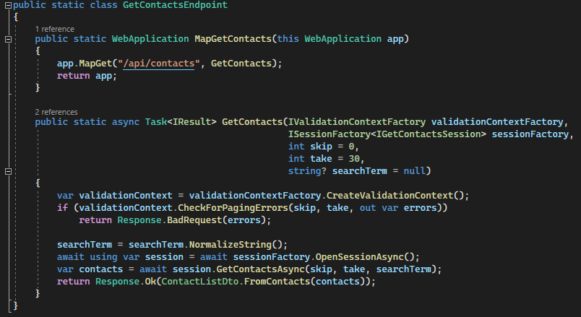
Which project structure scales well?
The endpoint methods can be called from unit tests without setting up the whole HTTP server
These methods should not be within a single Program.cs
I prefer one endpoint per file/class, but you can also achieve several endpoints per file
Another tip: create namespaces per use case, not for endpoints, data access, interfaces, enums, classes, etc.

Slide 11
Composing the web app

Slide 12
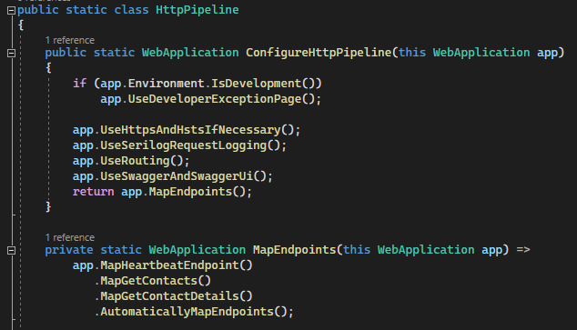
Manual endpoint registration
Dedicated calls to MapEndpoint methods
When a new endpoint is written, it must be explicitly added
Out of the box, there is no automatic registration like MapControllers, but you can easily build your own

Slide 13
Live Demo
A custom-built automatic registration mechanism for Minimal API endpoints

Slide 14
Dependency Injection and
Model Binding

Slide 15
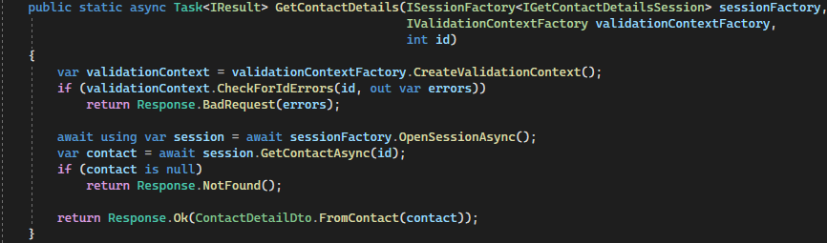
DI via Method Injection
By default, dependencies to other objects will be passed via Method Injection next to the regular parameters from the query or body of the request
Transient or scoped dependencies must be injected this way
You do not need to decorate parameters with [FromBody] or [FromServices]

Slide 16
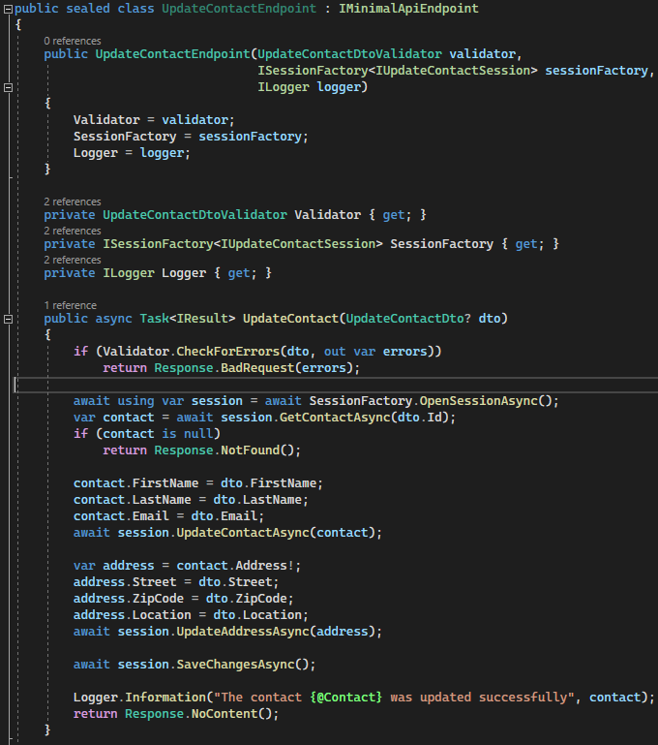
Injecting Singletons via the constructor
If you have an automatic registration mechanism that’s based on instantiating objects implementing a certain abstraction, you can use it to inject dependencies via the constructor
Beware: the dependencies become singletons when the mapped endpoint delegate references the object

Slide 17
Swagger Support

Slide 18
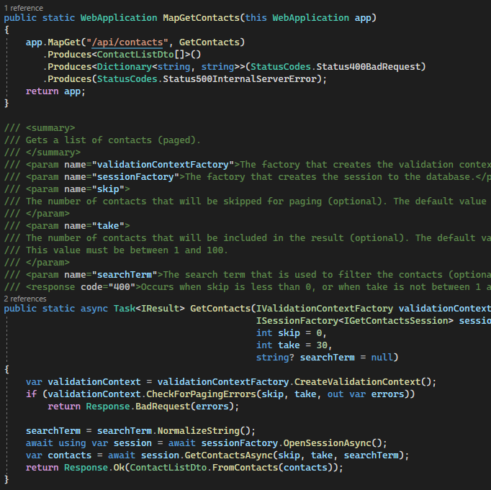
AspNetCore.Swashbuckle with Minimal APIs
The mapped delegates of Minimal APIs will be added to ASP.NET Core’s endpoints API explorer
When using methods, Swashbuckle can pick up the XML comments of those for documentation purposes
Configuration of Swagger/OpenAPI is not that different from ASP.NET Core MVC

Slide 19
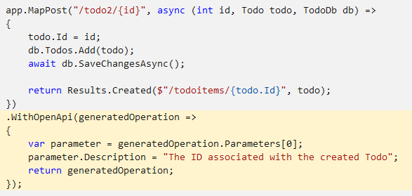
Swagger with anonymous methods in .NET 7
With the new Microsoft.AspNetCore.OpenApi NuGet package, you can imperatively describe your Web API endpoint
You can also mix this with the previously shown approach
https://github.com/dotnet/AspNetCore.Docs/pull/25863

Slide 20
Automated Testing of Minimal API Endpoints

Slide 21
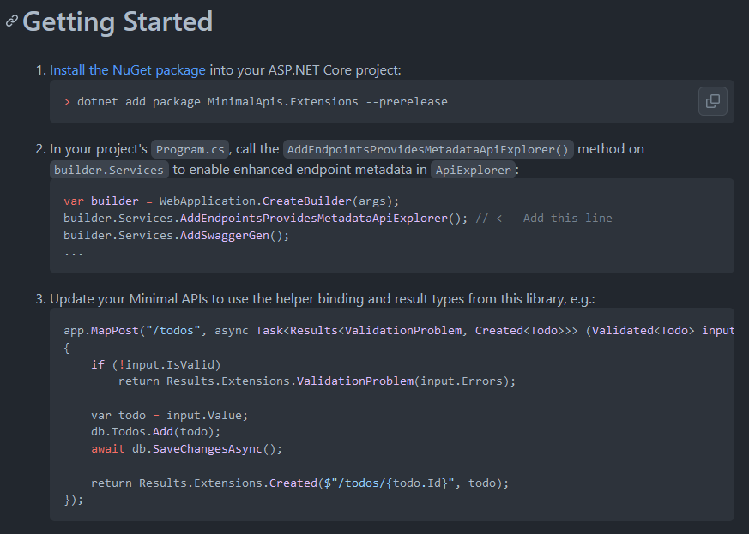
IResult makes unit-testing hard by default
The IResult implementations are internal and cannot be accessed in unit tests
Damien Edwards create MinimalApis.Extensions which also contains public implementations
We ended up creating our own because of some discrepancies: https://github.com/Synnotech-AG/Synnotech.AspNetCore.MinimalApis

Slide 22
Live Demo
Unit Testing a Minimal API

Slide 23
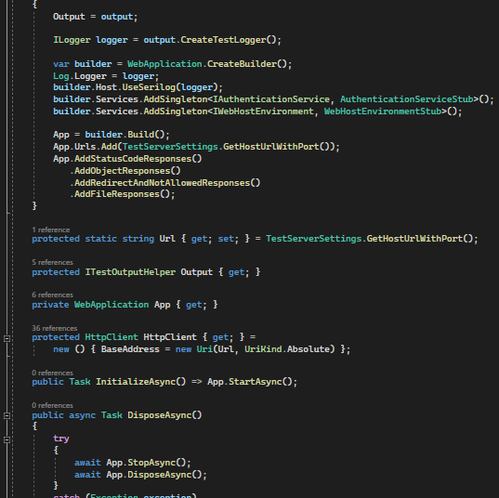
Integration testing of the full HTTP pipeline
Microsoft suggests using the WebApplicationFactory<T> (where T is either a Program or a Startup class)
We ended up writing our own base class for better integration with Xunit logging and more control over the configuration of the composition root

Slide 24
Validation of Query Parameters and Data-Transfer Objects

Slide 25
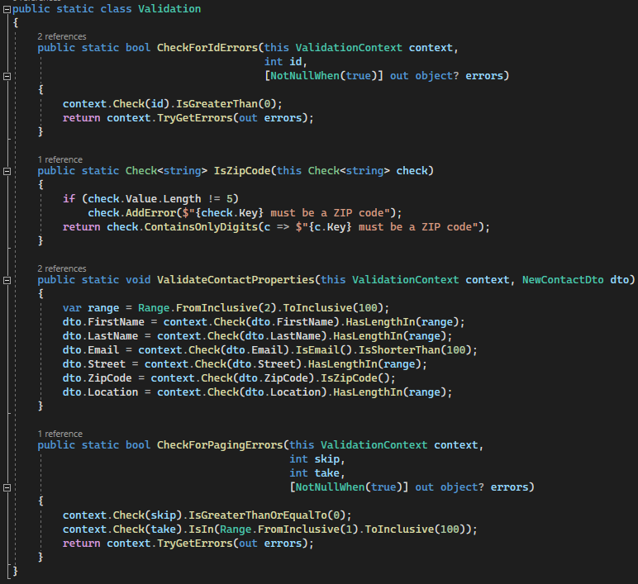
No built-in validation
Minimal APIs don’t contain any validation mechanism by default
MinimalApis.Extensions adapts System.ComponentModel.DataAnnotations with Validated<T>
FluentValidation has no integration for minimal APIs yet (ValidationResult must be converted into something useful for the response body)
I ended up creating Light.Validation

Slide 26
Performance of Minimal APIs

Slide 27
Performance advantage, but not that much

Slide 28
Conclusion
Web Application: way better than Program + Startup
Endpoint structure: I prefer one endpoint per file
DI and Model Binding: easier than in MVC
Swagger support: works, but the documentation doesn’t mention it
Validation: not built-in, only via extensions
Performance: better, but not that much

Slide 29
Thanks for your attention
Any questions?

